Slide 1
ESMBA
Club
Safeguarding Officers
Forum
Making clubs safe for 2023/24 and beyond

Slide 2

Club Safeguarding Officers
Club SGOs
The ESMBA recognises the important role you play at clubs.
This presentation aims to support you in that role. It will explain the policy and protocols
show to make yours a safe club, and
how to respond should and incident be reported to you.
It will help you to increase your profile to ensure Members know who you are and feel confident to approach you.

Slide 3

It is a common misconception that safeguarding is child protection
Child Protection is the actions taken once an individual Child or Adult is identified as suffering or likely to suffer harm as a result of abuse or neglect.
Safeguarding is the broader responsibility of all of us to ensure procedures are in place so that everyone can play bowls in a safe environment.

Slide 4
Your Safeguarding Role at Club
Make sure club members know who you are and how to contact you
Know the safeguarding Policy and procedure and Ensure your committee has adopted it into the club constitution
Promote a safe culture in your club –Be the first person on contact, listen to issues and act on them in accordance with the policy by reporting, as necessary. Maintain confidentiality but do not promise secrecy. Safeguarding issues involving children or adults as risk have to be reported to the County SGO who will deal with any necessary onward referral.
Be the eyes and ears in your club for Safeguarding professionals
Display the bi-monthly Safeguarding Bulletin in your clubhouse (if you have one)
Ensure your club has Codes of Conduct which are well known/displayed (noticeboard, handbook, website) – see BDA or NGB website
Put safeguarding on committee agendas
Know the contact details for Child Social Care (CSC), Adult Social Care (ASC) the Police and NGB Safeguarding Officer
Know your members and their needs. Hold the junior player profile if applicable

Slide 5

WHAT ISNT SAFEGUARDING
Don’t be the ‘catch all’ for everything that others don’t want to deal with!
Health and Safety issues
Arguments, fights
Unacceptable behaviour – drunkenness etc.
Dress code issues
Ask yourself – where is the abuse?
Check with your NGB Lead Safeguarding Officer.

Slide 6
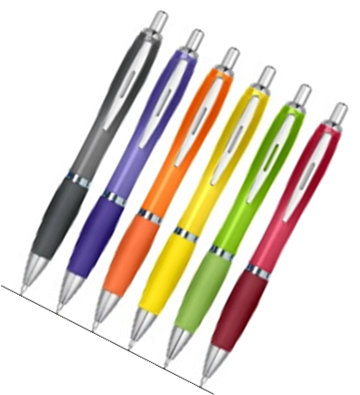
The Safeguarding policy.
There are differences between child and adult safeguarding
For Children there are 4 major categories of abuse (children act )
Physical Abuse
Emotional Abuse
Neglect
Sexual Abuse
FOR ADULTS at Risk there are 10 categories ( Care Act 2014)
Physical Abuse
Psychological or Emotional Abuse
Neglect or Acts of Omission
Self-neglect
Sexual Abuse
Domestic Violence
Financial or Material Abuse
Organisational or Institutional Abuse
Modern Slavery
Discriminatory Abuse

Slide 7

RECEIVING A CONCERN
DO DON’T
Take is Seriously Dismiss it
Stay Calm and listen Panic
Be Sensitive Make Assumptions
Explain what will happen next Promise secrecy
Make notes as soon as possible about the nature of what you have been told. Ask open questions Tell, Explain, Describe (TED)
Listen and identify the type of concern. It is safeguarding, is it disciplinary, is it adult, is it criminal, is it a low level breach of conduct?
Take appropriate action and follow the ESMBA procedures.

Slide 8
Working together at all the stages of Safeguarding
Who is involved?
Club and County Officers and Committees
Dorset County Lead SGO
Lynn Dean
ESMBA Lead Safeguarding Officer
Lynn Dean
ESMBA Case Management Group
Bowls Development Alliance
Full Time Safeguarding Lead
Duncan Webster
BDA Case Management Group 5 bowls Lead Officer
Child Protection in Sport Unit (CPSU)
Liza Ware
Ann Craft Trust (ACT)
Nicola Dean / Joanne Pell

Slide 9
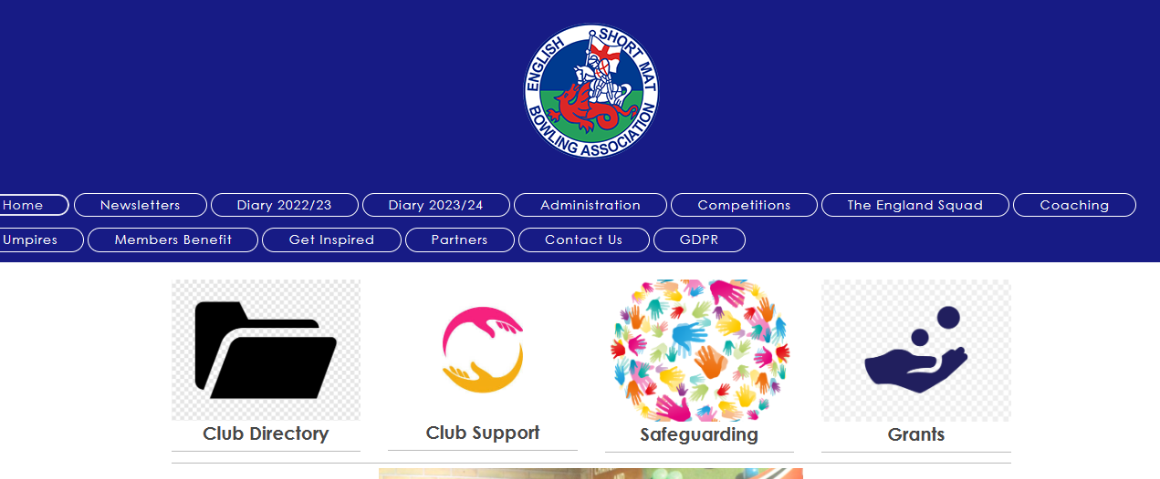
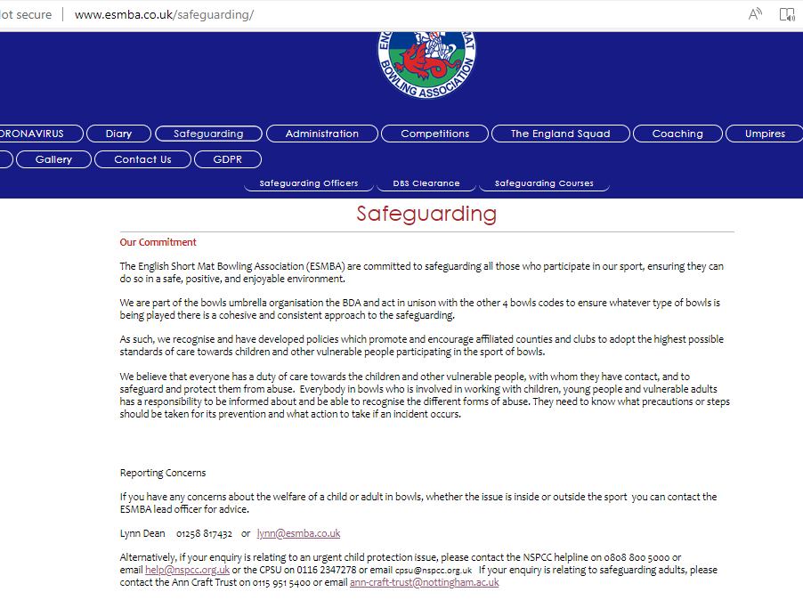
www.esmba.co.uk
A Safeguarding page details all relevant contact information both within the ESMBA and externally.
There is a direct link on the safeguarding pages to
* BDA policy/Guidence/templates Resources - Bowls Development Alliance
* Available Training courses Training - Bowls Development Alliance
You can view and download
The AGM Forum presentation
This CSGO presentation
Safeguarding Newsletter bulletins The English Short Mat Bowling Association (ESMBA) - Safeguarding News Bulletins

Slide 10
Clubs should have in place
A Club safeguarding officer.
Robust Constitution – Reviewed every 3 years which includes a disciplinary and appeals process. The English Short Mat Bowling Association (ESMBA) - Disciplinary and Appeals procedure
Safe membership policy – A membership form which collects information regarding any new member.
Code of conduct for members

Slide 11
Disciplinary and Appeals process
Does your Club have one they follow?
The English Short Mat Bowling Association (ESMBA) - Disciplinary and Appeals procedure
Clearly defines the process for any complaint. How it should be raised, who should assess the case, the time frame to resolve it.
Accurate record keeping is important to ensure transparency and support defensible decision making

Slide 12
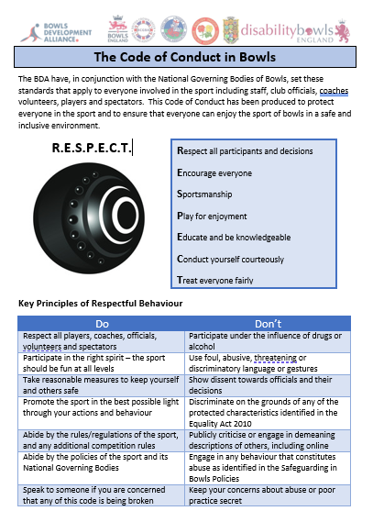
Code of Conduct
Templates are available or create your own.
Members sign up to the clubs standards and requirements
They become the foundation of any complaint.

Slide 13
Safe Membership
Name and Date of Birth
Address and contact details
Next of Kin
Any medical or health issues
References

Slide 14
Junior Player Consent forms
Parental Consent form includes
Age, Emergency contact details and any medical conditions
Photographic Permission Form
Which gives the club and the county the permission to take photos and publish them for the promotion of achievement and of the sport in general
Code Of Conduct
As mentioned this is needed for parents as well as the juniors to ensure boundaries are set and agreed from the outset.

Slide 15
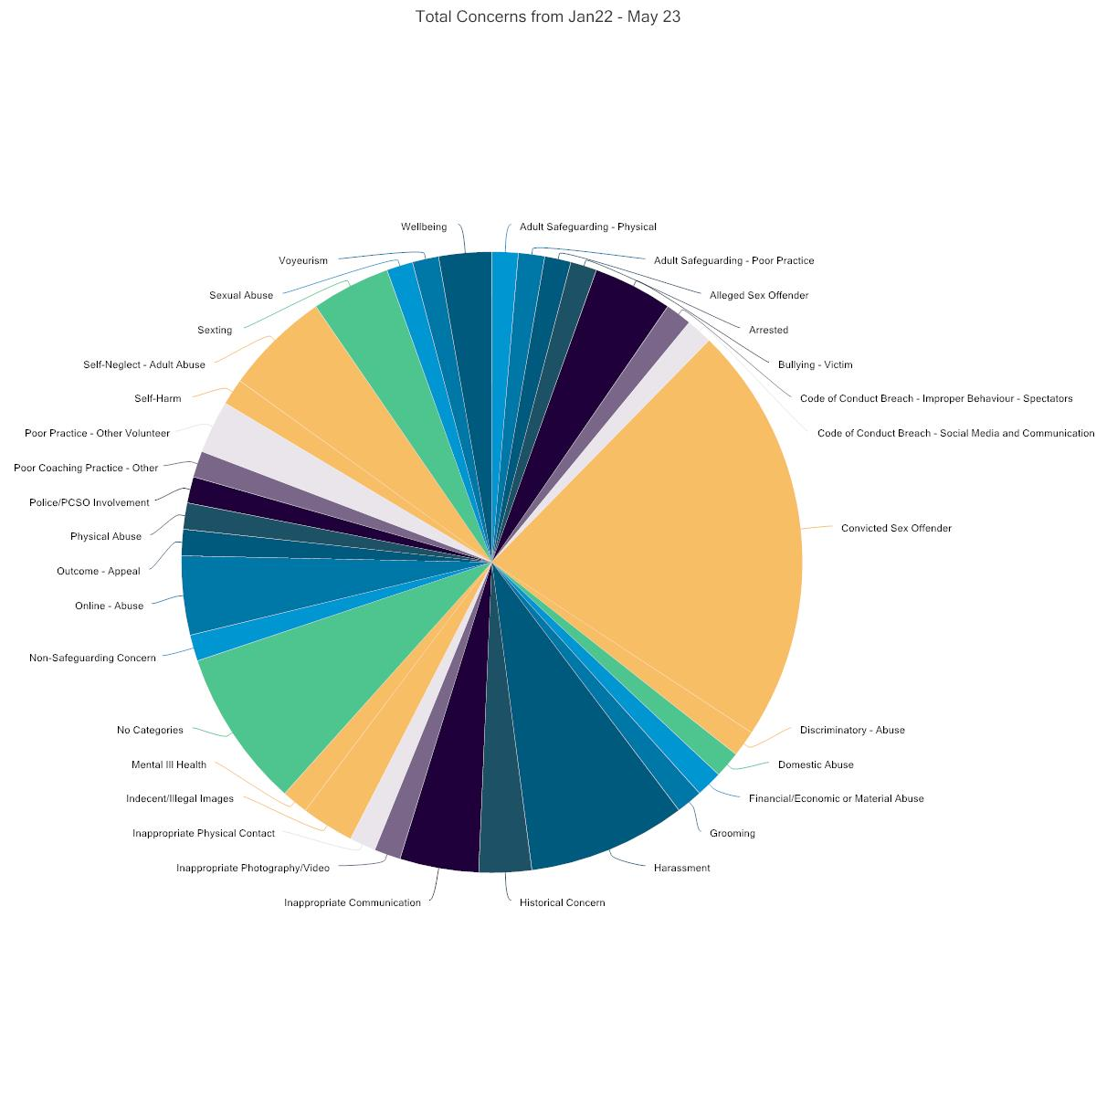
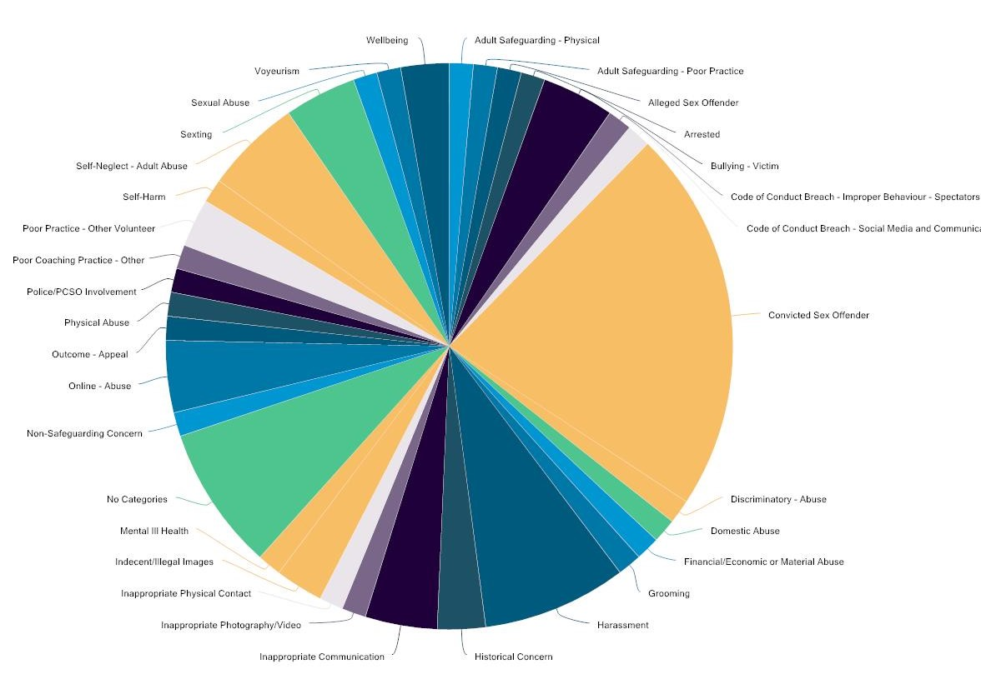
My Concern - Data Collection
From Jan to June 23 - 69 Cases have been brought to the BDA CMG
Diverse cases across a wide spectrum from poor practice and member wellbeing, to disability discrimination from identity theft, to historic and current sexual offences
Its important to document them all to help build a picture and ensure a consistent approach

Slide 16
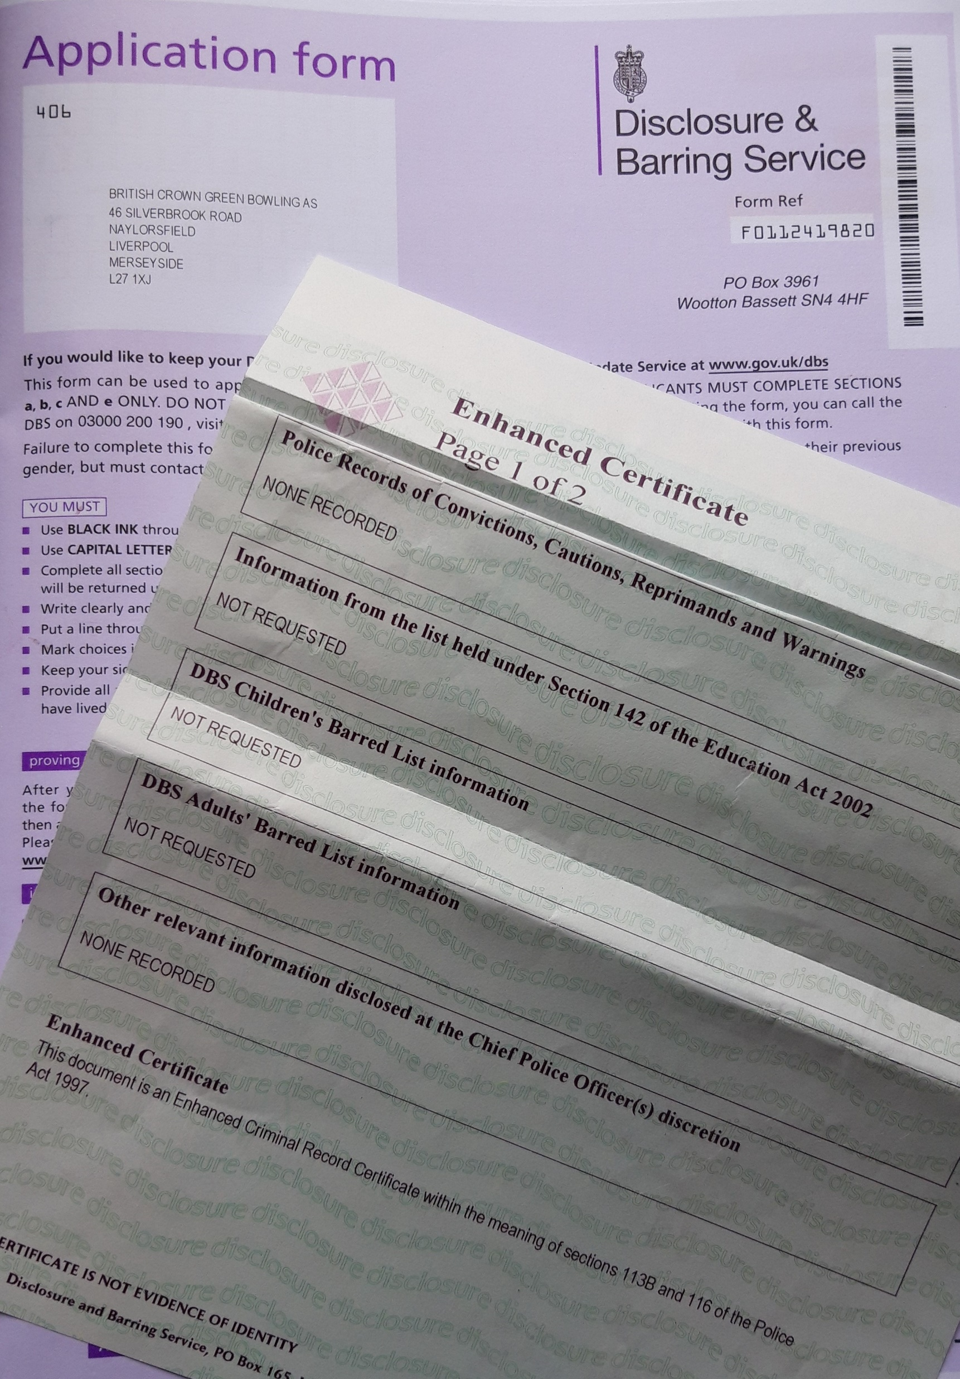
DISCLOSURE AND BARRING SERVICE
DBS – How it works
A DBS application form is completed by the applicant and checked with the help of the local CSGO.
Application cost is currently £12
Processing time is approx. 2 weeks
The applicant is checked to ensure they are suitable to work with children and adults at risk
Upon issue the County / ESMBA must see and approve the certificate and applicant should register for the online update service
www.gov.uk/dbs-update-service
A DBS is required for CSGOS, ESMBA Committee members, ESMBA Coaches and ESMBA Umpires.
Additionally at County level it is recommended team managers, Committee members, competition organisers and club SGOs are checked.
DSMBA hold a data base but clubs should also be proactive and aware of who in their club have one and when they expire/need to be rechecked

Slide 17
Further training opportunities
BDA e-learning
Education - Bowls Development Alliance
Coach Bowls online courses.
Adult Safeguarding in Bowls | Coach Bowls
Safeguarding: Time to Listen | Coach Bowls

Slide 18
Who to Contact
NGB Lead officer - 01258 817432 or email lynn@esmba.co.uk
NSPCC Tel No 0808 800 5000 or email help@nspcc.org.uk.
CPSU Tel No 0116 234 7278 or email cpsu@nspcc.org.uk
ANN CRAFT TRUST Tel 0115 951 5400 or email
ann-craft-trust@nottingham.ac.uk
Know your own Local LADO / SOCIAL SERVICES
POLICE / AMBULANCE

