Slide 1


Safeguarding

Slide 2
SAFEGUARDING – aim of today
Overview of the BDA
Safeguarding Officers
New leaflet
My Concern
Data Collection
Financial abuse

Slide 3
Bowls Development Alliance
Supportive alliance for Bowls NGB’s
Case Management
Steering Group
Policies and procedures
Strategic and operational

Slide 4
SAFEGUARDING OFFICERS
2028 deadline
Trained and confident

Slide 5
SAFEGUARDING OFFICERS
Safeguarding means protecting a citizen’s health, wellbeing and human rights; enabling them to live free from harm, abuse and neglect. It is an integral part of providing high-quality health care. Safeguarding children, young people and adults is a collective responsibility (NHS)
Sport England – duty of care to members
Whyte review.

Slide 6
SAFEGUARDING KEY PRINCIPALS
Empowerment: People being supported and encouraged to make their own decisions and informed consent.
Prevention: It is better to take action before harm occurs.
Proportionality: The least intrusive response appropriate to the risk presented.
Protection: Support and representation for those in greatest need.
Partnership: Local solutions through services working with their communities.

Slide 7
How do we create a safe platform?
Safeguarding Officers
Constitution
Safer membership
Codes of Conduct
Everyone’s responsibility
Templates
Club Matters section of ESMBA website

Slide 8
My Concern
Collaborative approach
99 cases
Case themes
September Updates

Slide 9
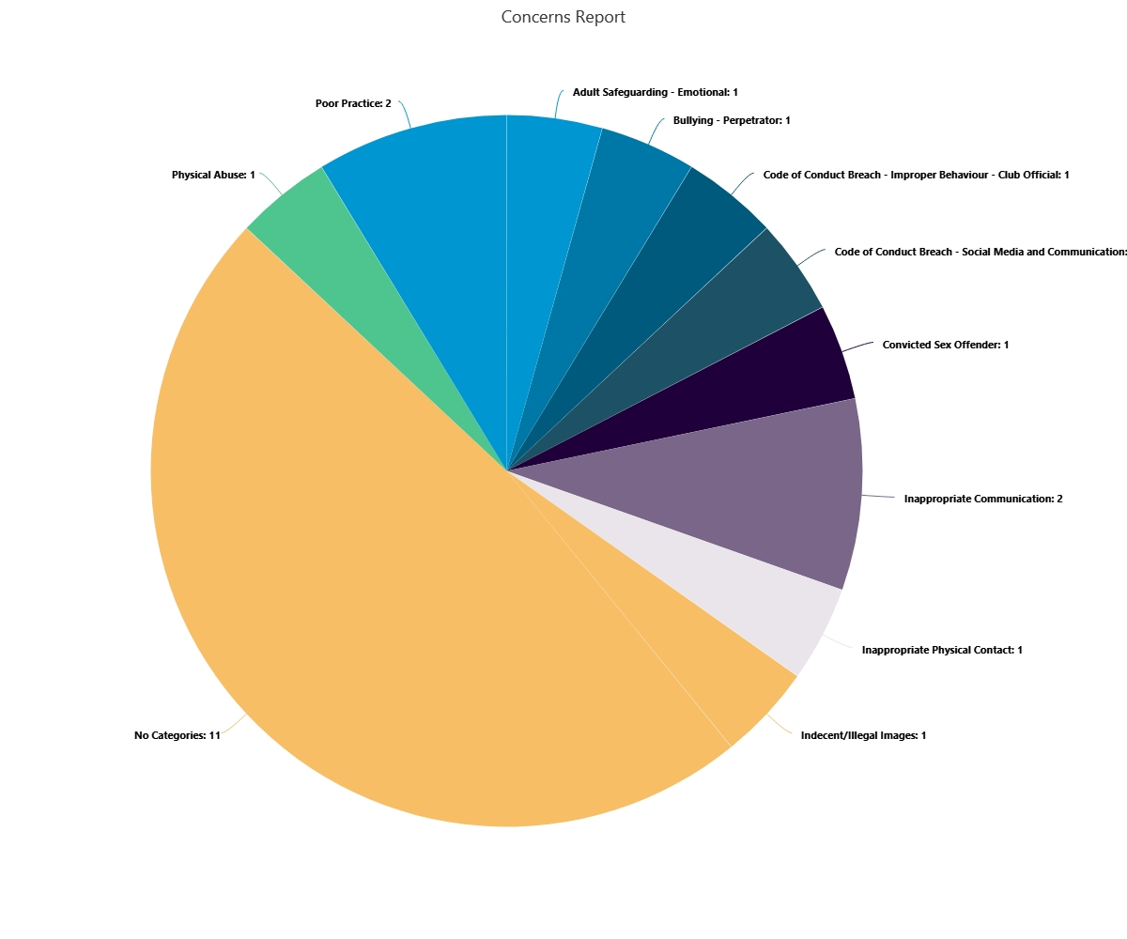
My Concern

Slide 10
Data Collection
Improve our vision across the sport
Safeguarding at club / county level
The slippery slope…
Let ESMBA know

Slide 11
Financial Abuse
Financial abuse is the mistreatment of someone in terms of their money or assets, such as their property (Age UK)
Adults at risk of scams
Members at risk from other members
Talk to others

Slide 12
Leaflets – by the door. Will also be distributed to county
Any Questions?

